Slide 1


Overview of the KBCSD
(Korea Business Council for Sustainable Development)
1405 Trade Tower, 511, Youngdong-daero, Gangnam-gu, Seoul Korea
TEL: +82 2 6000 7662, Fax: +82 2 6000 7671, Email: master@kbcsd.or.kr, Web: www.kbcsd.or.kr

Slide 2
Who we are
Introduction
KBCSD(Korea Business Council for Sustainable Development) is a CEO-led organization of
76 forward-thinking companies that endeavors to put Korean industry on track to economic
development in harmony with environment and social development.
KBCSD is a global network partner of the WBCSD(World Business Council for Sustainable Development)
History
2002 : Inaugural General Meeting held on March 21
* Dr. Dong-Soo Hur, Chairman of GS Caltex Corporation, appointed the first Chairman of KBCSD
2009 : Designated as a focal point for ‘Green Growth Business Dialogue’ under the Presidential
Committee on Green Growth
(Recognized as a premier business voice in shaping national sustainability policies)
2012 : WBCSD Annual Council Meeting held in Seoul, in commemoration of the 10th Anniversary of
the establishment of KBCSD
2015 : Sustainable Korea 2030 Master Plan established and officially announced
Korea-China CEO Roundtable on Sustainable Development launced in Beijing
2016 : Dr. Myung-Ja Kim, former Minister of Environment, appointed the second Chairperson of KBCSD
2018 : Mr. Myung-Soo Huh, Vice Chairman of GS E&C, appointed the third Chairperson of KBCSD
2020 : Mr. Kyong-Ho Lee, Chairman of Younglim Timber, appointed the fourth Chairperson of KBCSD
Membership
KBCSD membership spans 74 enterprises that are spearheading sustainable business practices
Member companies comprise diverse industrial sectors as follows:
oil refinery and gas, steel, electrical and electronics, petrochemical, construction,
aviation, automobile, paper and pulp, accounting and consulting, telecommunications,
power utility, agriculture, etc.

Slide 3
What we do
Public-Private Policy Consultation | Convene CEO gatherings with high-level officials from politics, government and the National Assembly with a view to providing business inputs regarding pending policy issues on sustainable development (Invitees include Prime Minister, Minister of Environment, Minister of Trade, Industry and Energy, etc.)
Policy Research | Provide a platform for member interaction in developing sustainability policies, publishing policy recommendation reports, etc.
Visions and Roadmaps | Establish mid-, and long-term visions and action plans for the business sector in its response to major sustainability megatrends (Sustainable Korea 2030 Master Plan)
Capacity-Building | Enhance capacity-building and information-sharing for member companies associated with sustainability management through specialized education programs
Media Relations | Hold KBCSD Media Awards on Sustainability on an annual basis to promote public and media awareness of sustainable development
International Relations | Interact closely with WBCSD, CBCSD, Nippon Keidanren, ADB, GCF and other like-minded organizations to promote regional and global collaboration in such fields as climate change, energy, inclusive business, and global CSV Help member companies advance sustainable business practices by introducing best practice models and implementation tools proven by leading global expertises Spearhead green initiatives in Asia by holding ‘Korea-China CEO Roundtable on Sustainable Development’ aimed at expanding low-carbon, green business opportunities

Slide 4
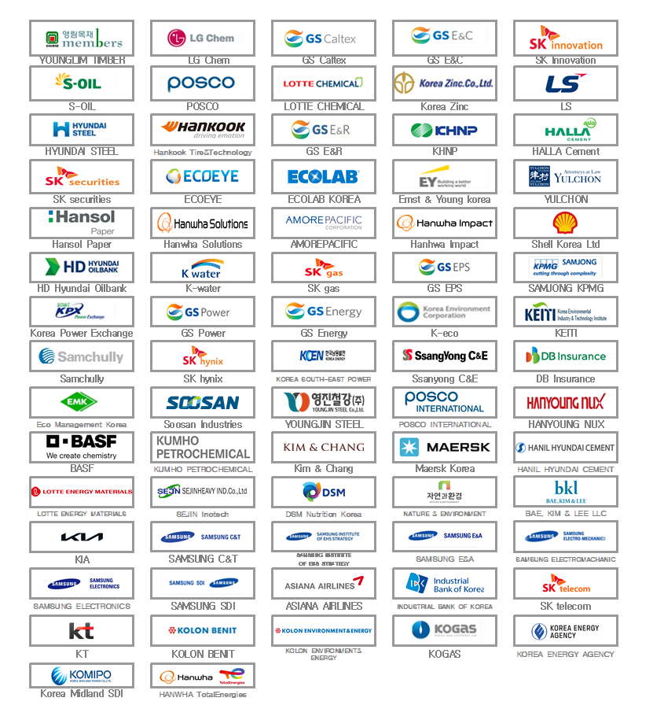
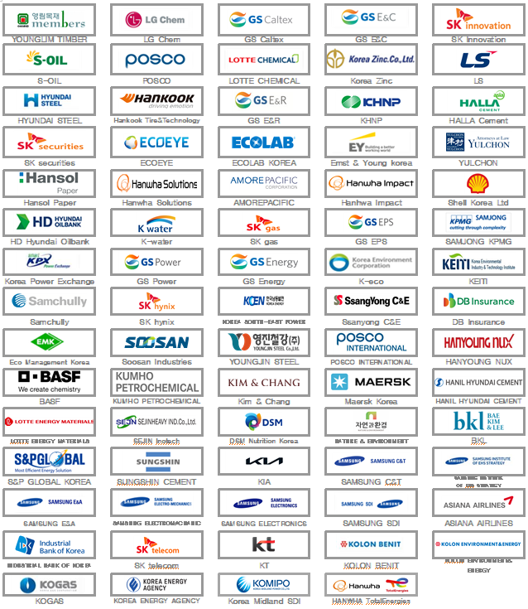
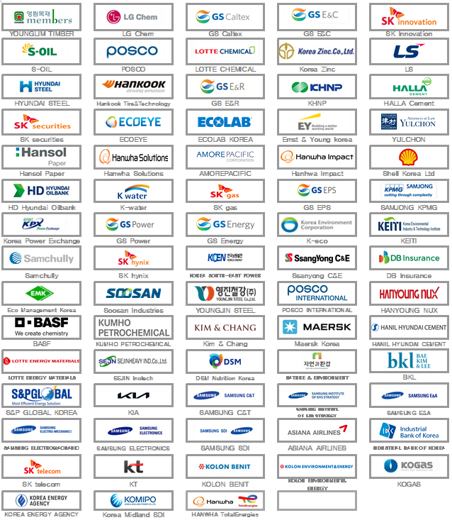
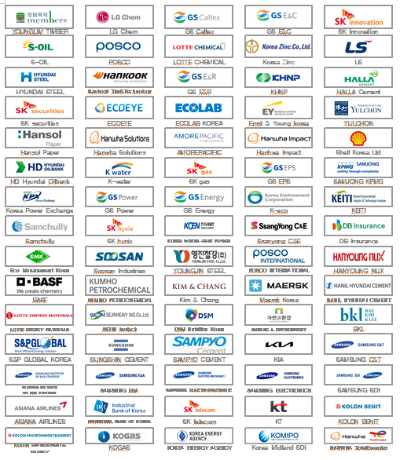
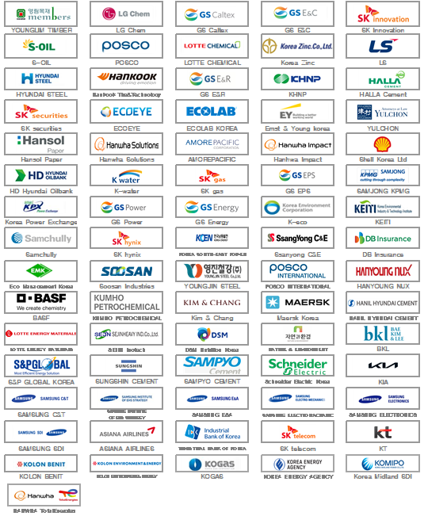
KBCSD Members
Honorary Chairmen :
Dong-Soo Hur, Honorary Chairman of GS Caltex
Myung-Ja Kim, Advisor and Presidential Committee of National
Cohesion(Former Minister, Ministry of Environment) of KAIST
Myung-Soo Huh, Vice Chairman of GS E&C
Chairman :
Kyong-Ho Lee, Chairman of Younglim Timber
76 Member Companies
Senior Vice Chairman :
Hak-Cheol Shin, CEO of LG Chem
Vice Chairmen :
Sang-kyu Park, CEO of SK innovation
Anwar A. Al-Hejazi, Representative Director and CEO of S-OIL
Tae-Jin Kim, President of GS E&C
Young-jun Lee, CEO of Lotte Chemical
Moo-Kyung Jung, President of Sustainability Management Unit of Korea Zinc
Hee-geun Lee, CEO of POSCO
Jung-Su Kim, Executive Vice President of GS Caltex
Board Members :
Roe-Hyun Myung, President and CEO of LS Corp
Jong-Sun Ah, CEO of Hankook Tire & Technology
Gang-Hyun Seo, President and CEO of Hyundai Steel
Seoung-Won Kim, CEO of GS E&R
Joo-Ho Whang, President of Korea Hydro & Nuclear Power Co., Ltd
Kyung-Tai Lim, CEO of Halla Cement Corp.
Shin Kim, CEO of SK securities
Soo-Bok Lee, President of Ecoeye Co. Ltd
Yang-Kwon Ryu, Market Head of Ecolab
Auditor :
Yong-Guen Park, CEO and Regional Managing Partner of EY Korea
Dong-Ryul Choi, Managing Partner of Yulchon

Slide 5
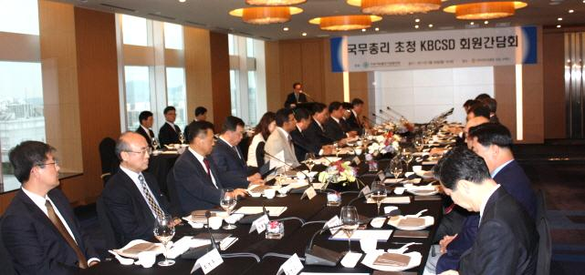
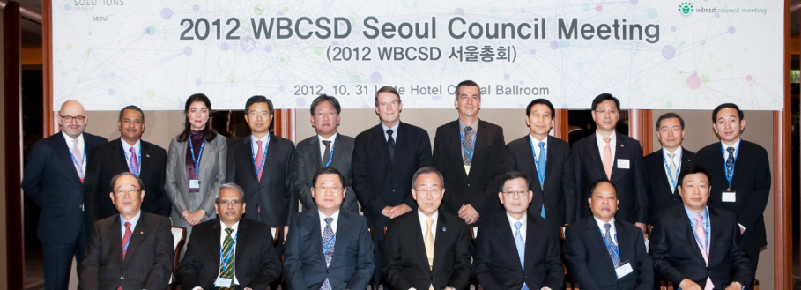
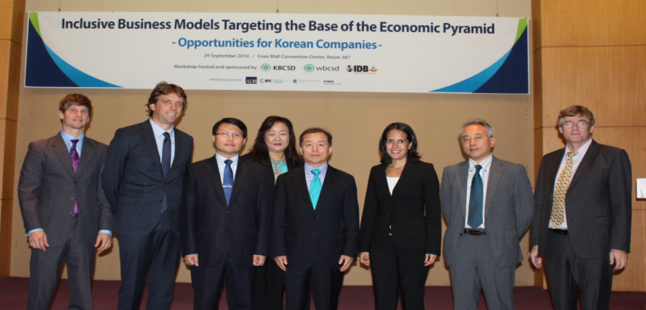
KBCSD Networks
• Government : Ministry of Environment, Ministry of Trade, Industry & Energy,
Ministry of Land , Infrastructure & Transport, Office for Government Policy Coordination, etc.
• National Assembly : Climate Change Forum, Environment & Labor Committee,
Industry & Trade Committee, Sustainable Development Committee, etc.
Government /
National Assembly
WBCSD, CBCSD, Nippon Keidanren, ADB,
GCF, GGGI, UN, and 60 BCSDs,
The industry
International
Organizations like
WBCSD and etc
76 major large businesses,
6 major business associations,
other industrial associations
Research Institute,
Law firm, Consulting
Media
Maeil Business Newspaper, Chosun Ilbo,
Seoul Broadcasting System (SBS),
Dong-A Ilbo, etc.
Samjong KPMG LLC, Ernst&Young,
KOLON BENIT, Attorneys at Law
Yulchon, Samsung Institute of EHS Strategy, etc.

Slide 6
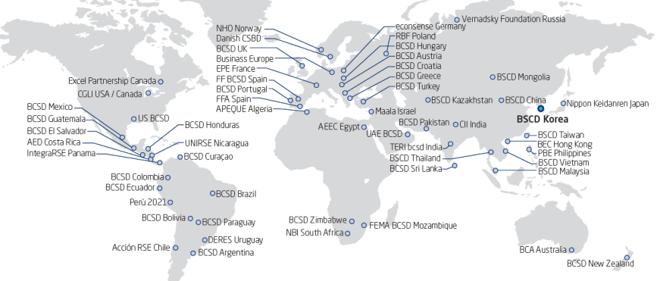
[Annex] Introduction of WBCSD
WBCSD (World Business Council for Sustainable Development)
Founded in 1991 by a request of UNCED as a global CEO-led organization serving as a leading voice of business in support of sustainable development
Currently, CEOs of more than 200 global companies around the world are actively engaged in the Council
  Majority of members are in the upper ranks of ‘Fortune Global 500 companies’ and ‘Global 100 Most Sustainable Companies’ (annually announed in the Davos Forum)
Ilham Kadri Syensqo CEO serves as the Chair of WBCSD
WBCSD Global Network

Slide 7
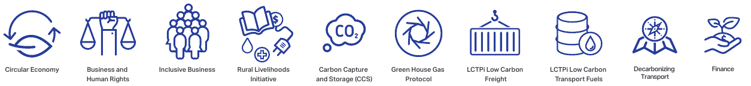
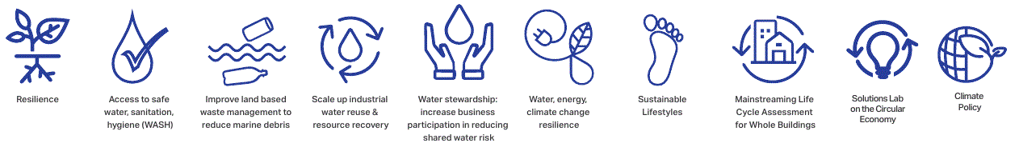
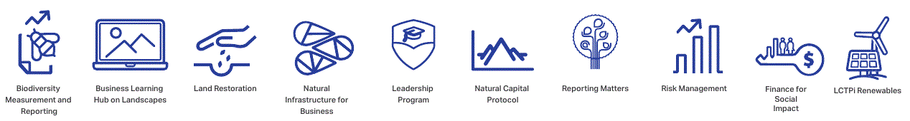

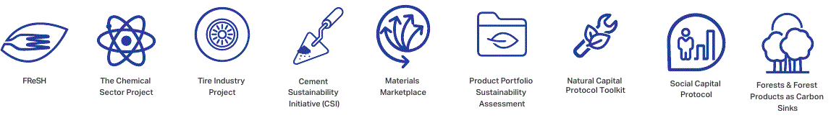
What WBCSD Does
WBCSD helps member companies integrate successful sustainability into their core business strategies.
manage risks, anticipate consumer demand, build positions in growth markets, secure access to needed resources, and strengthen their supply chains, etc.

